Slide 1
Issues to talk about
Jan-6-2021

Slide 2
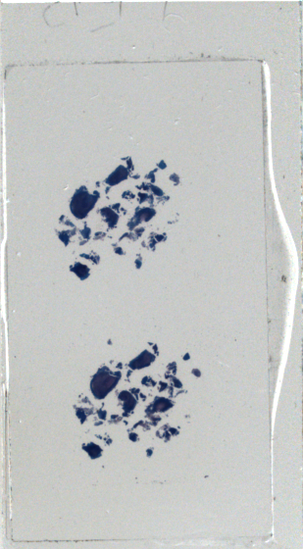
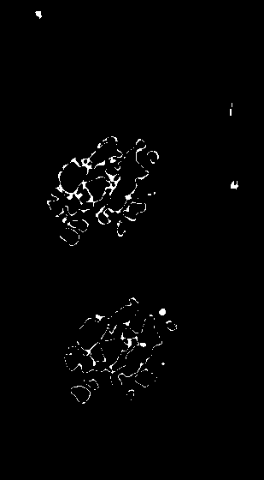
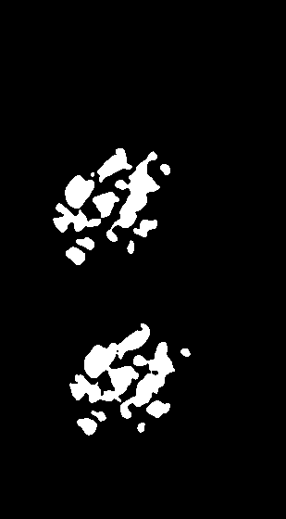
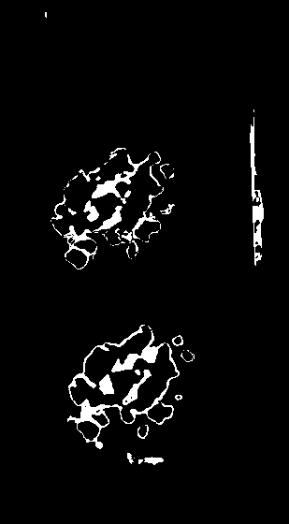
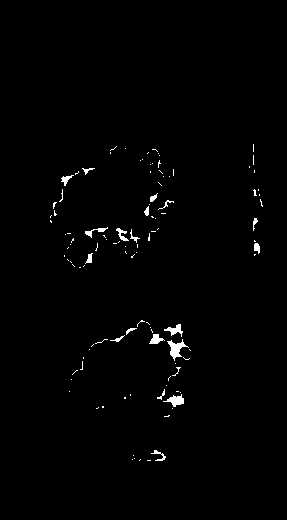
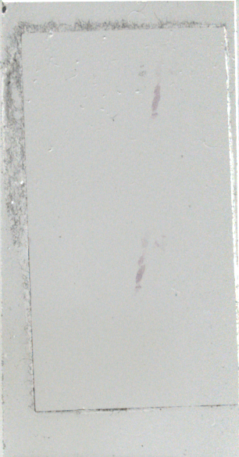
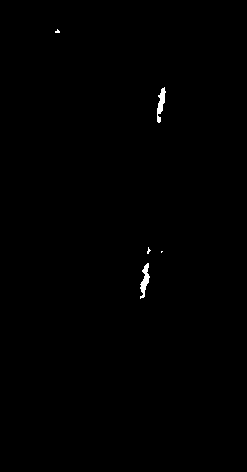
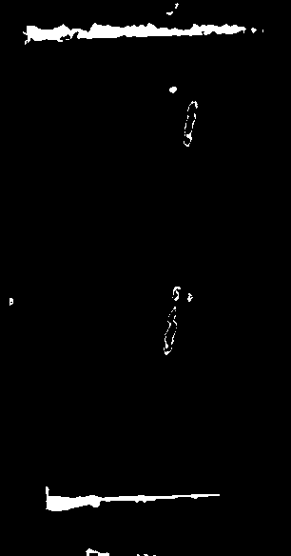
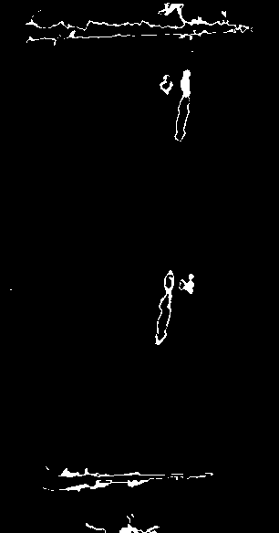
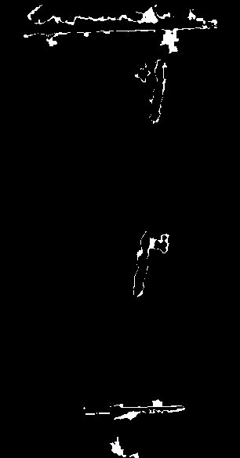
 | Class 1 | Class 2 | Class 3 | Class 4
H01CBA05P_39021
Coverslip Line
PPP5246

Slide 3
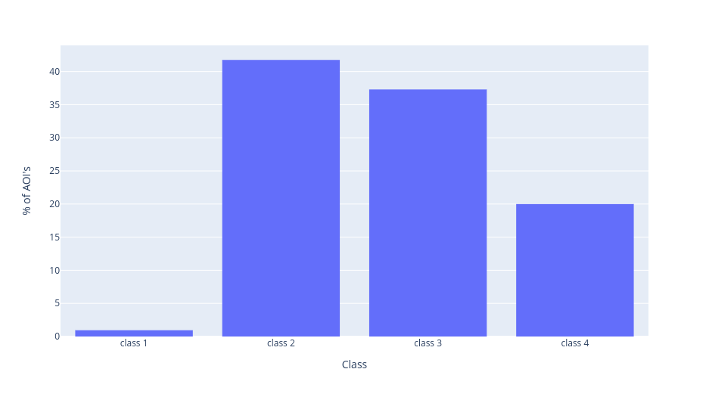
Coverslip class Distribution
Dataset used was composed of slides where grids were over the coverslip region.
AIM of this experiment was to identify above mentioned regions and their corresponding classes.

Slide 4
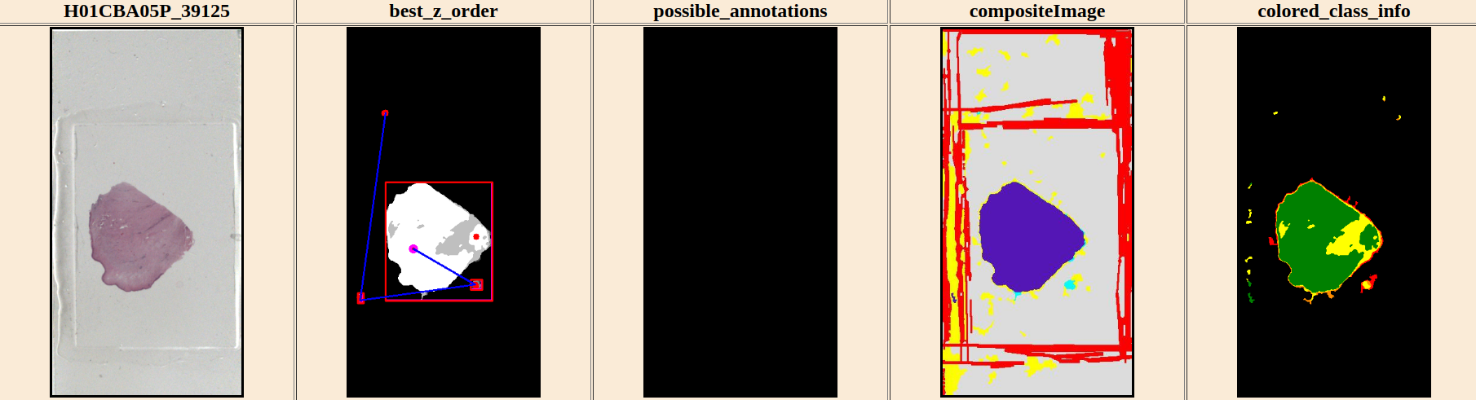
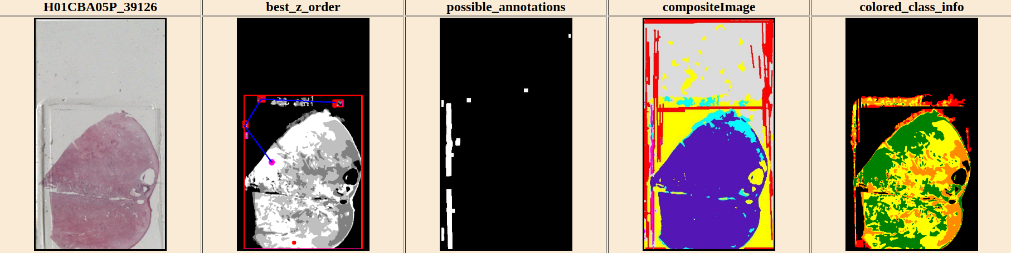
A breakage inside of Class 1
Class 1
Class 2
Class 3
Class 4
Colored Class
Information

Slide 5
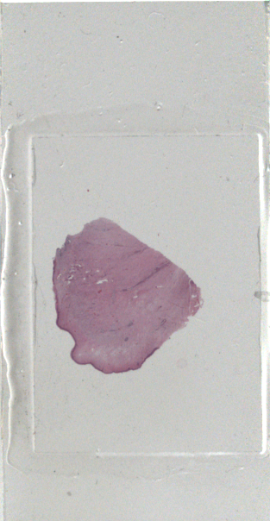
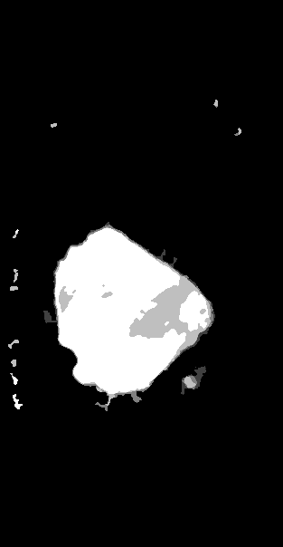
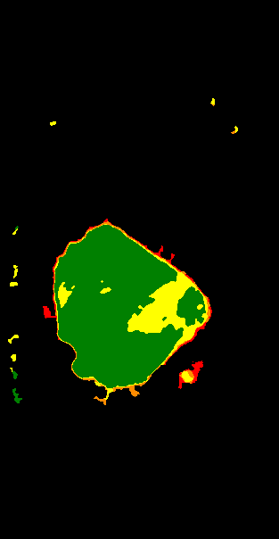
White Corrected Input
Dense region NLMD
Colored class Info

Slide 6
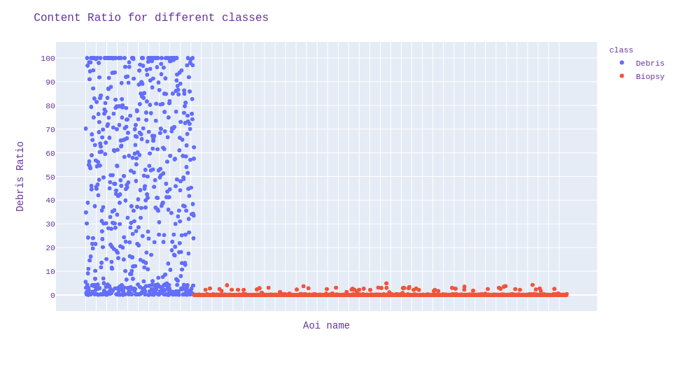
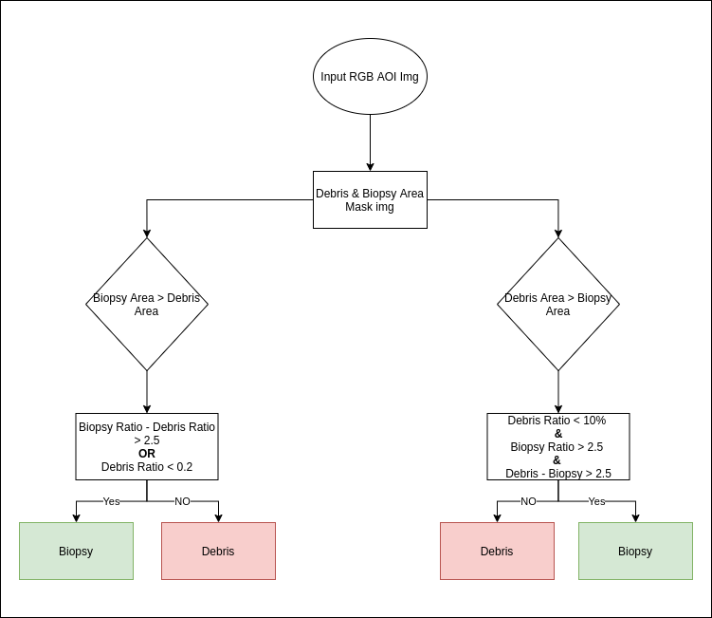
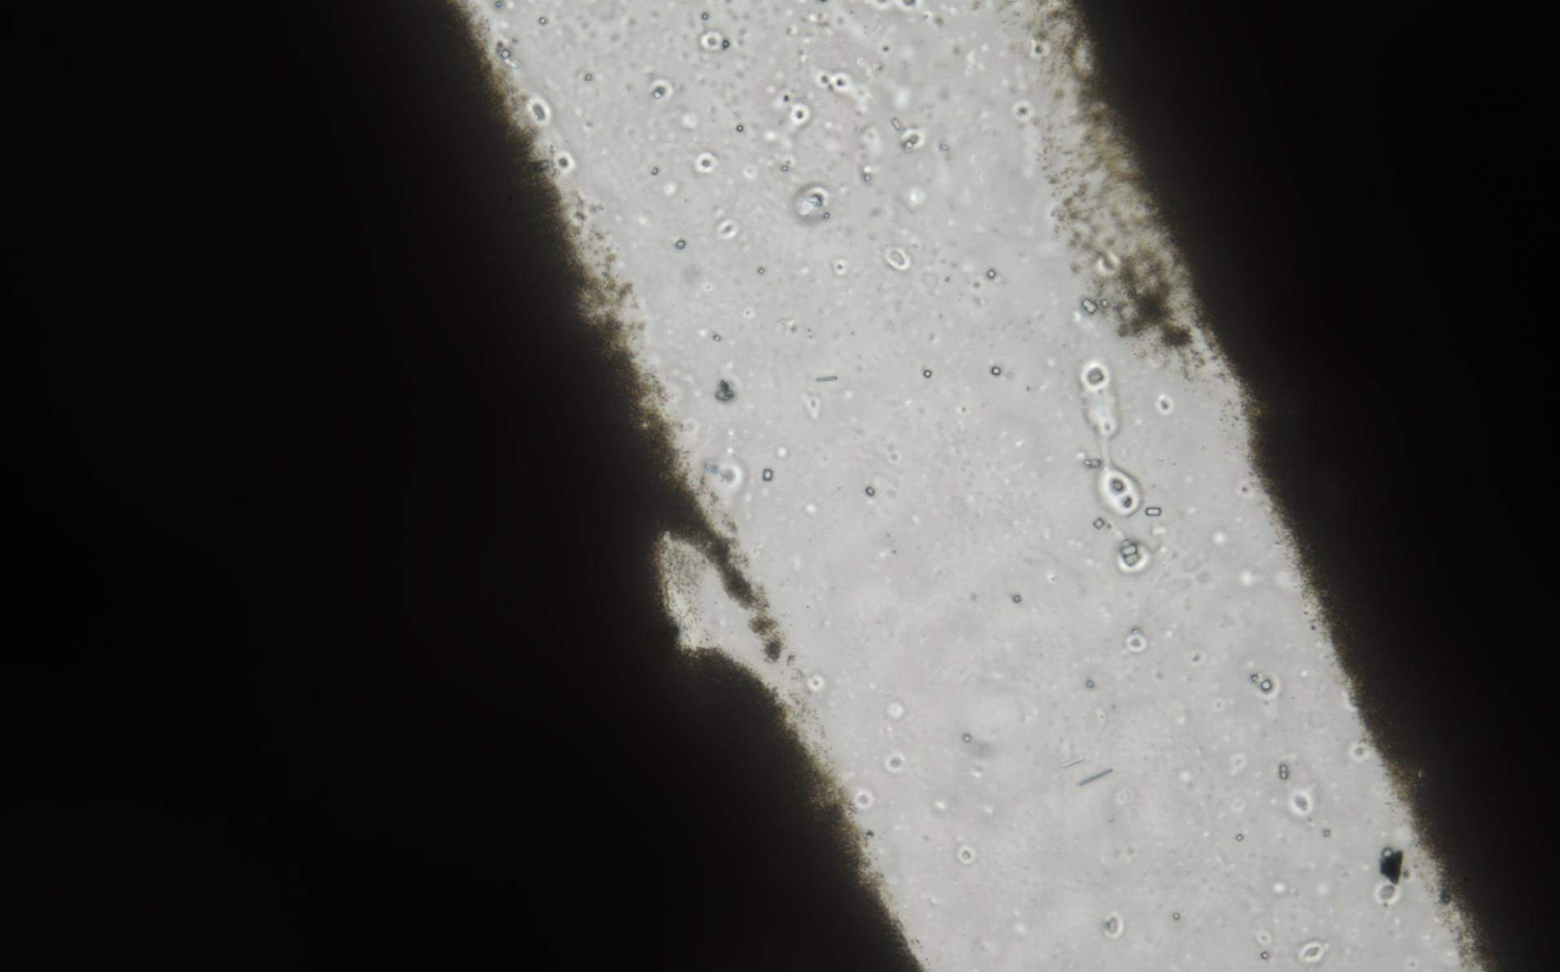
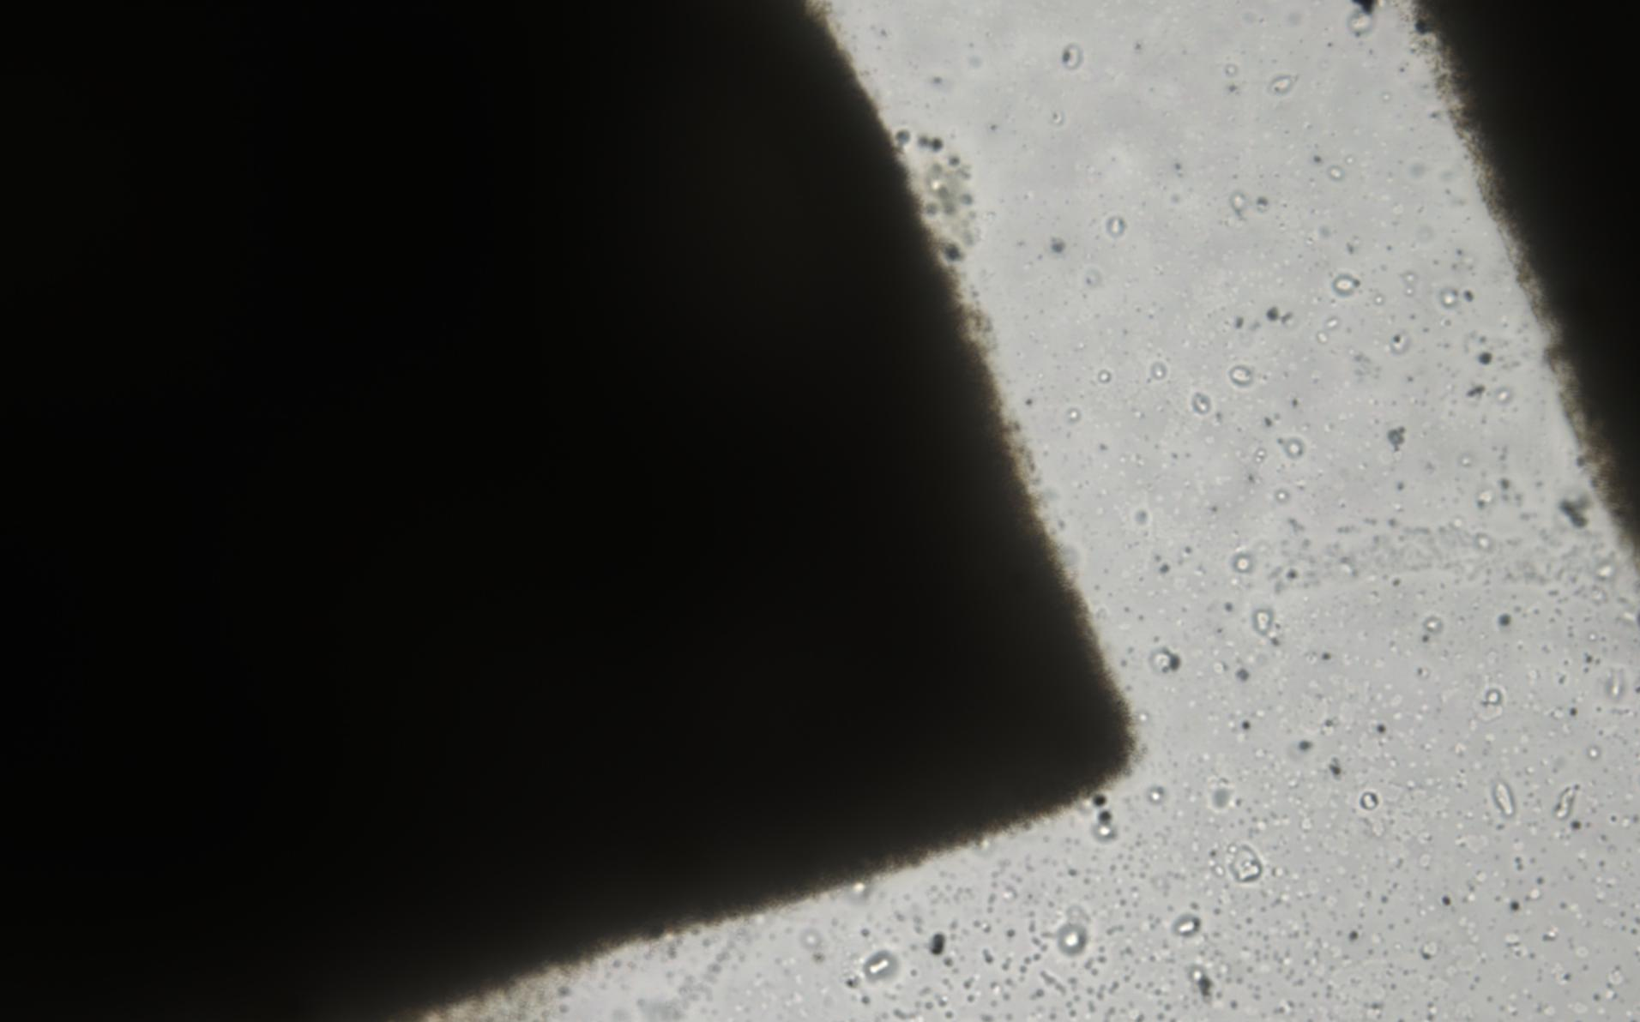
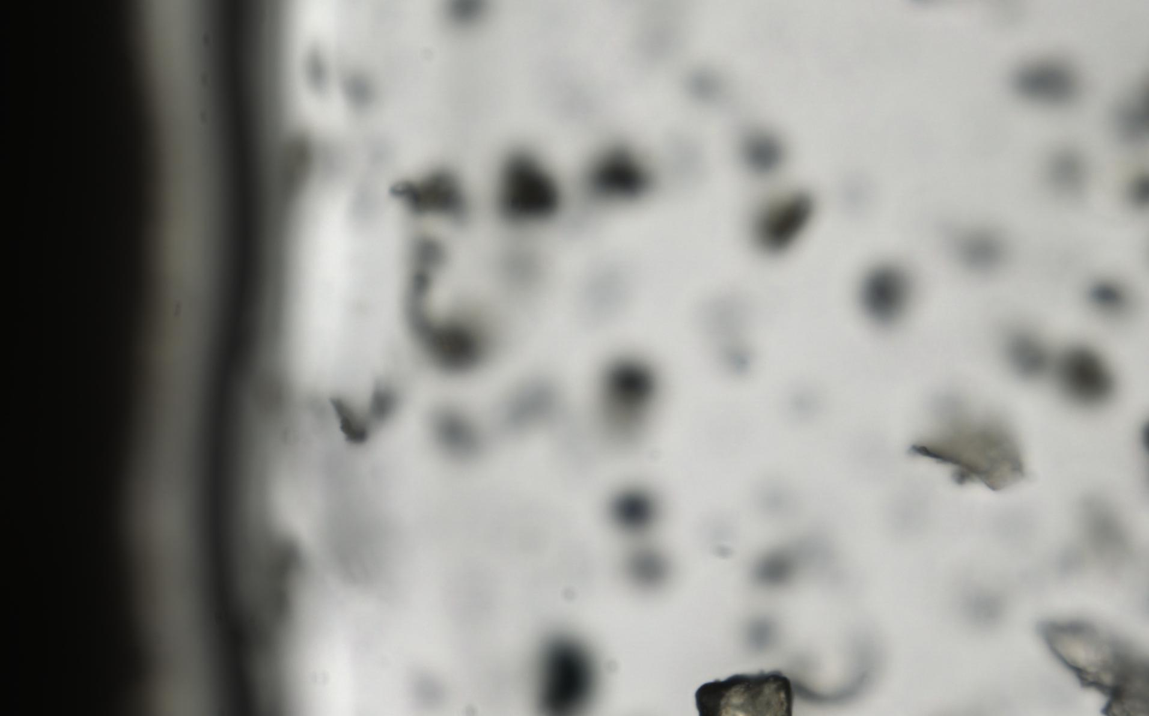
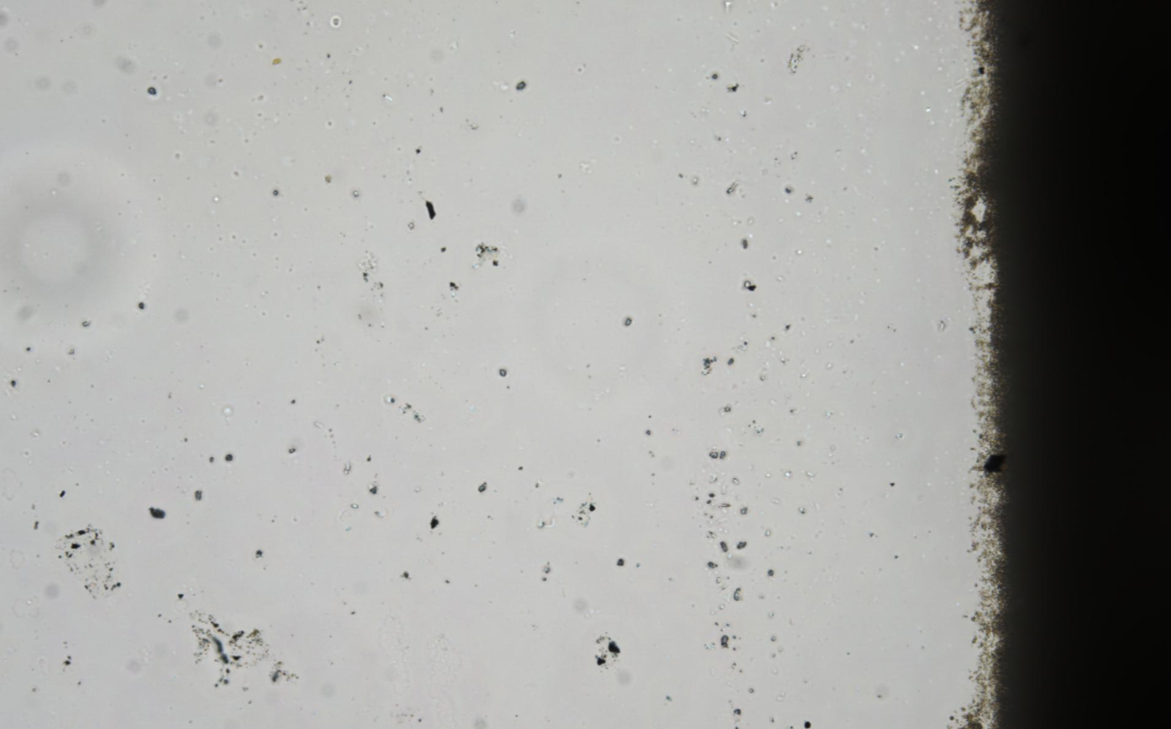
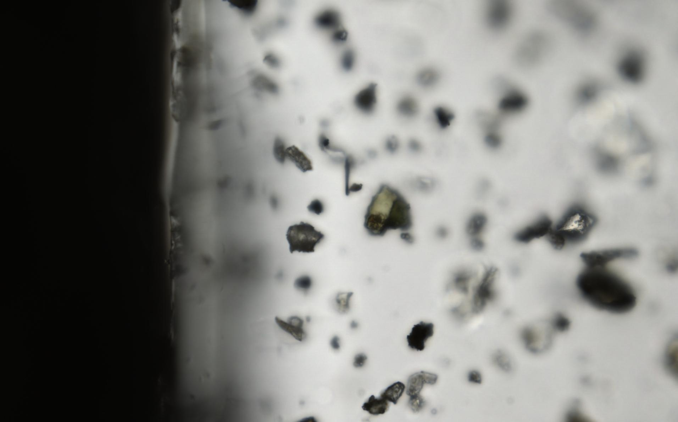
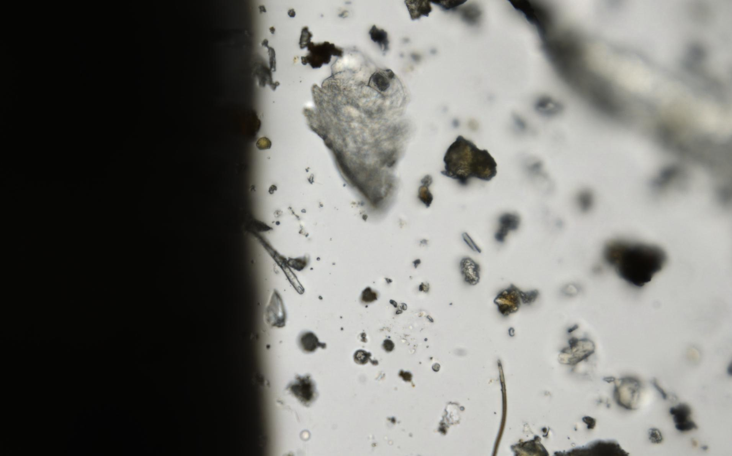
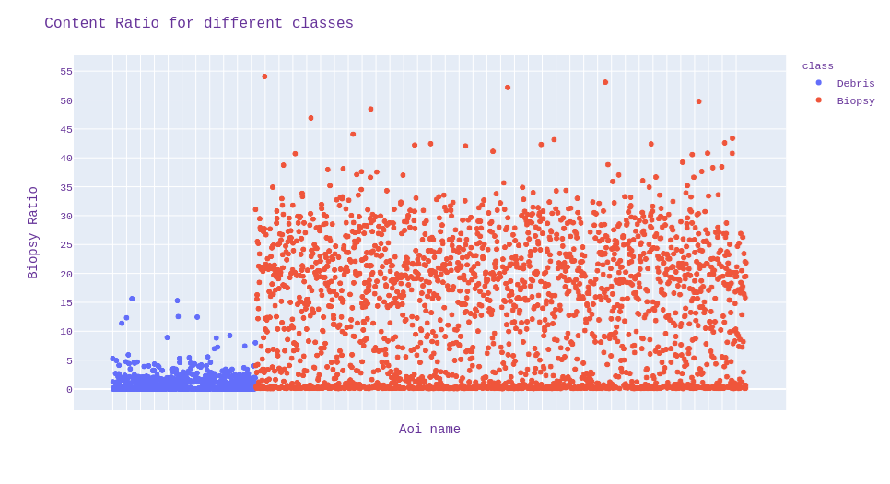
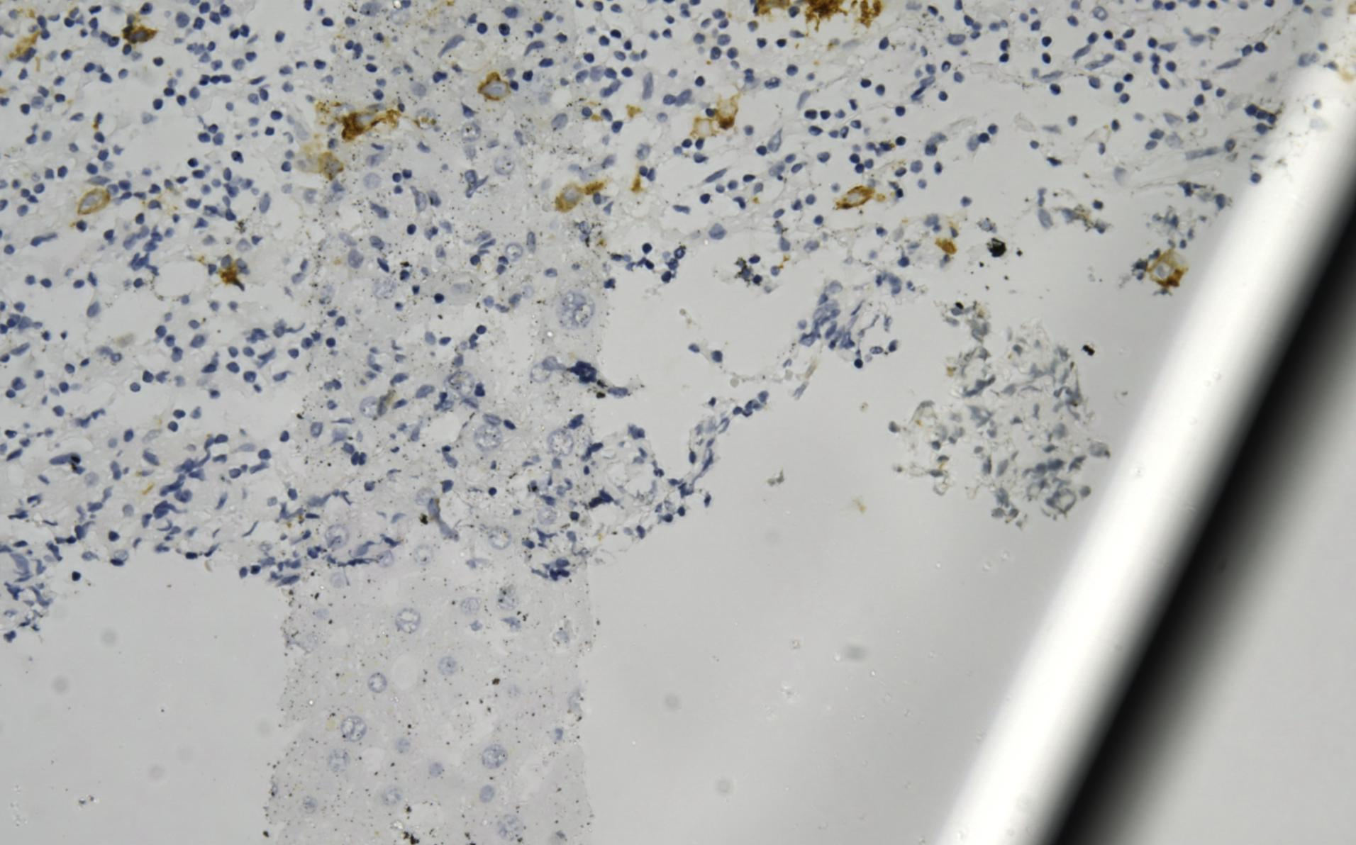
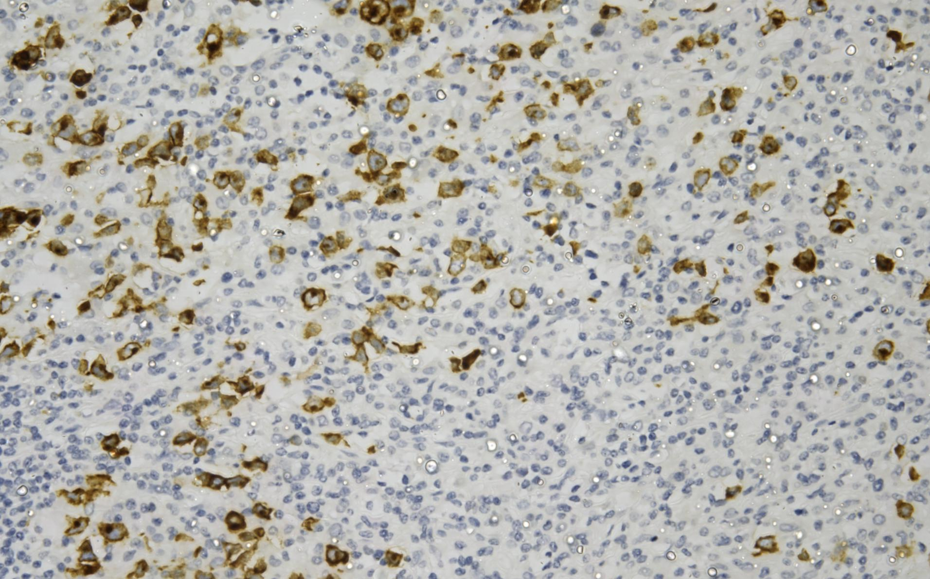
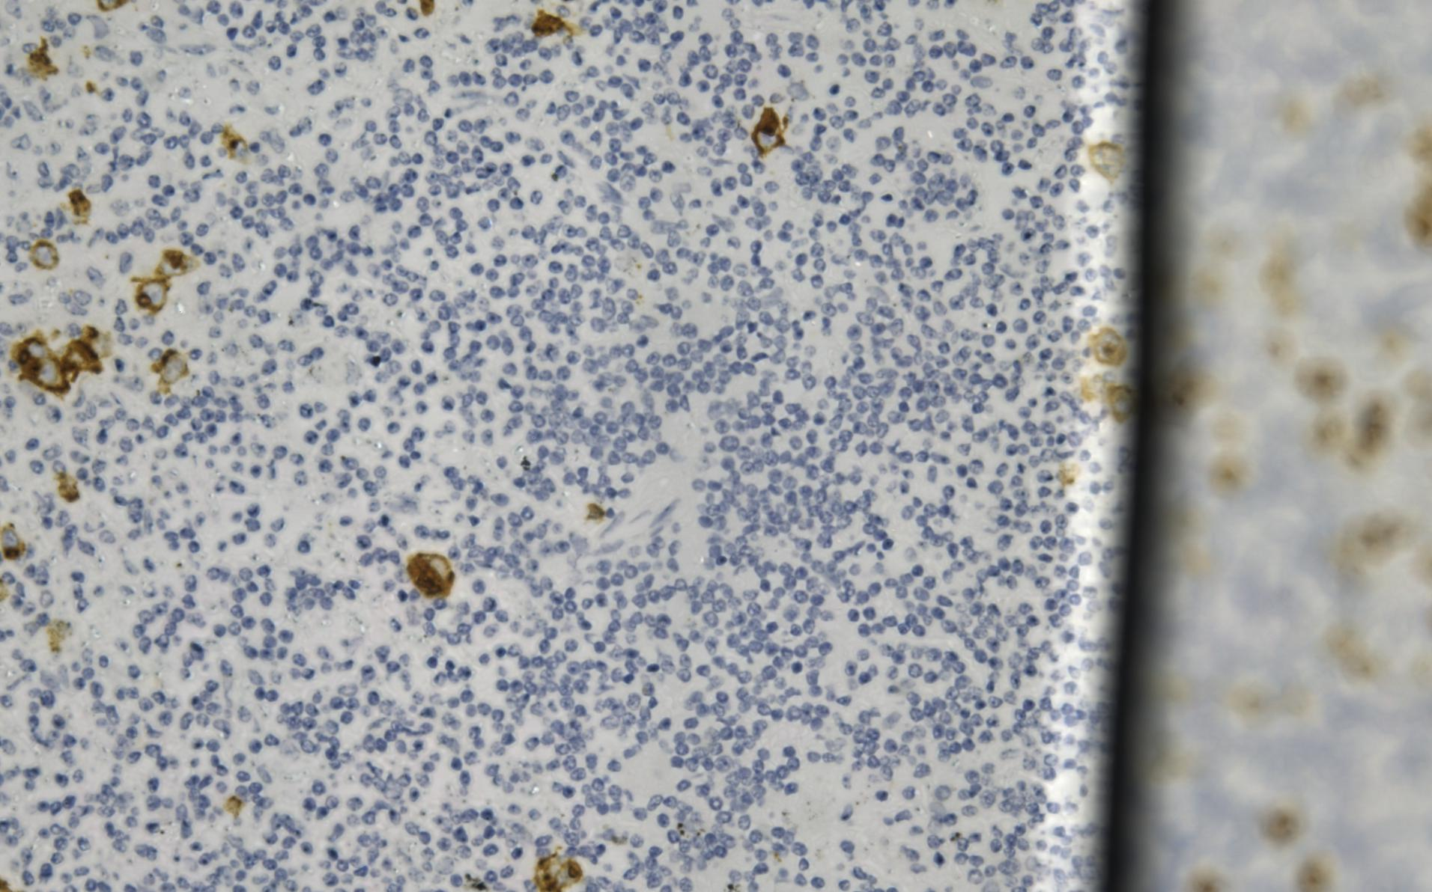
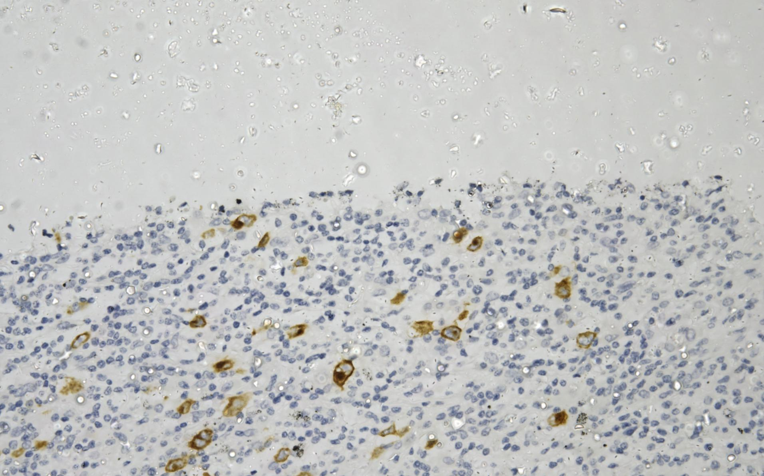
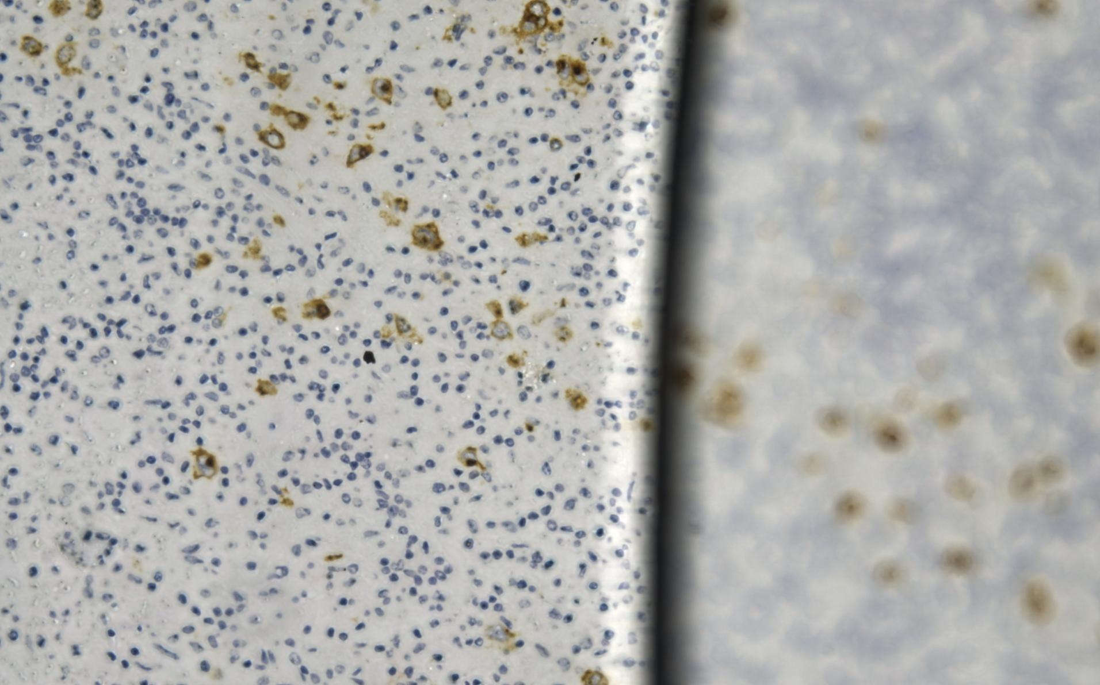
Decision Criteria's
Debris Content Distribution within the AOI's usually Annotations the cover slip regions or the deposits
Biopsy Content Distribution within the AOI's

Slide 7
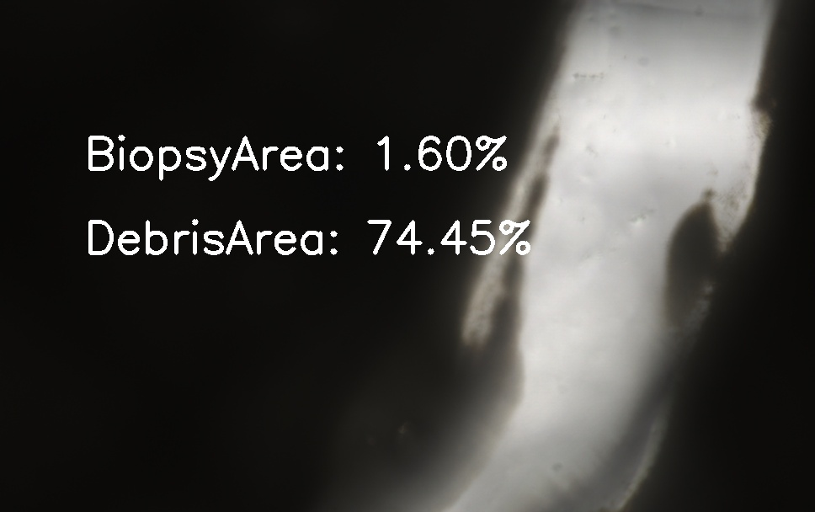
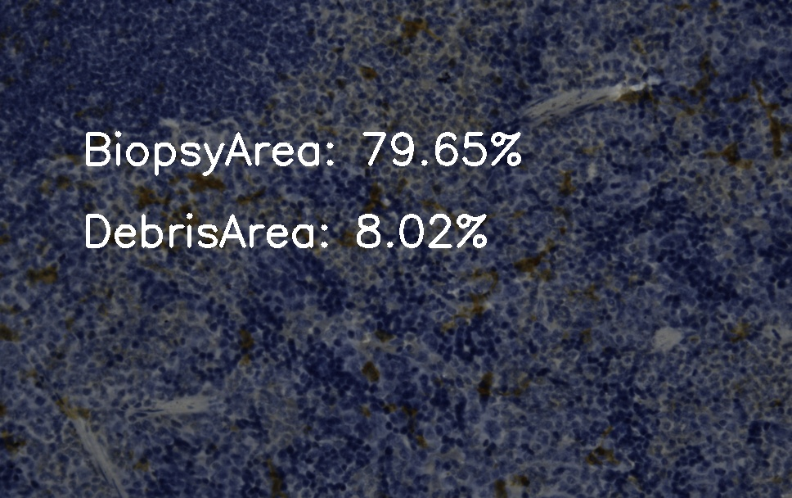
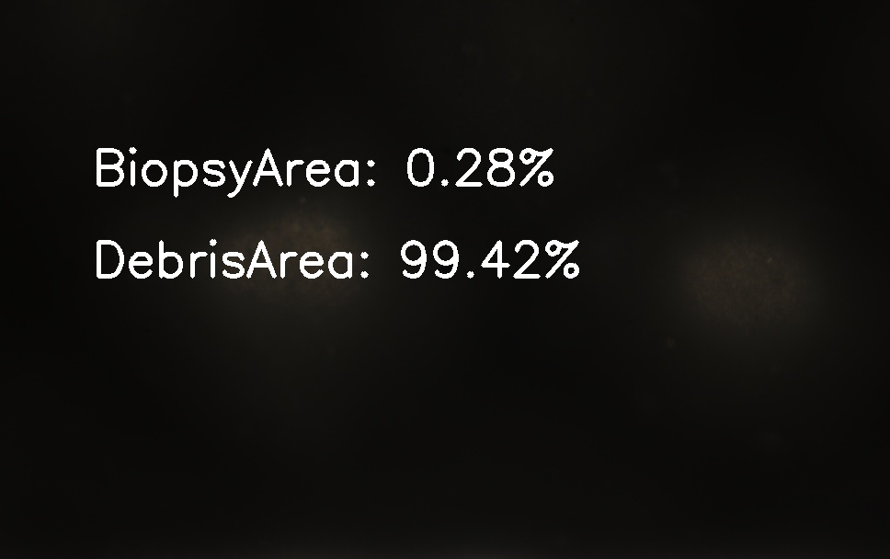
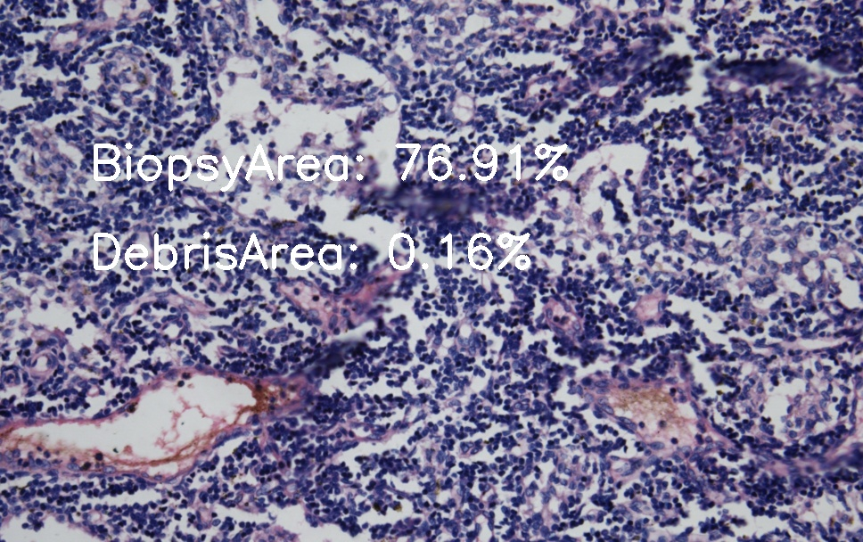
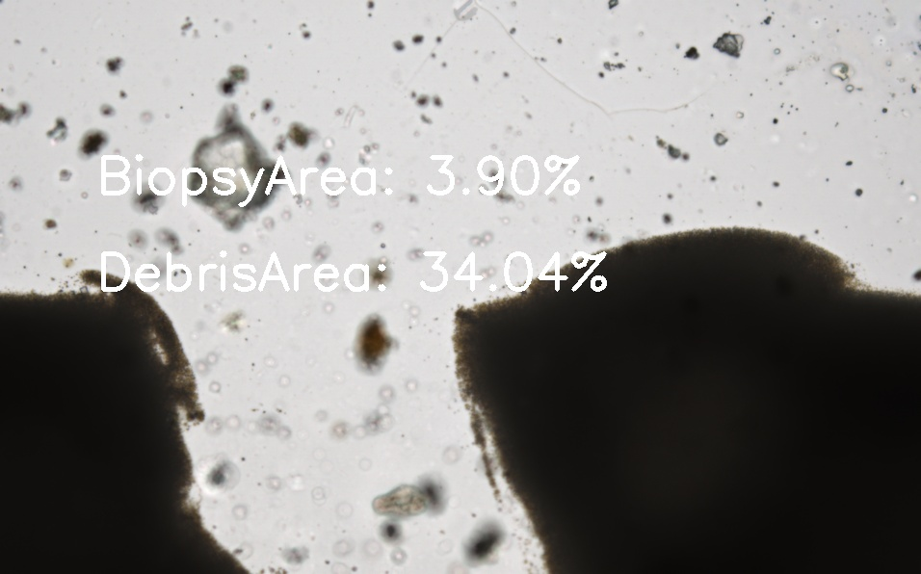
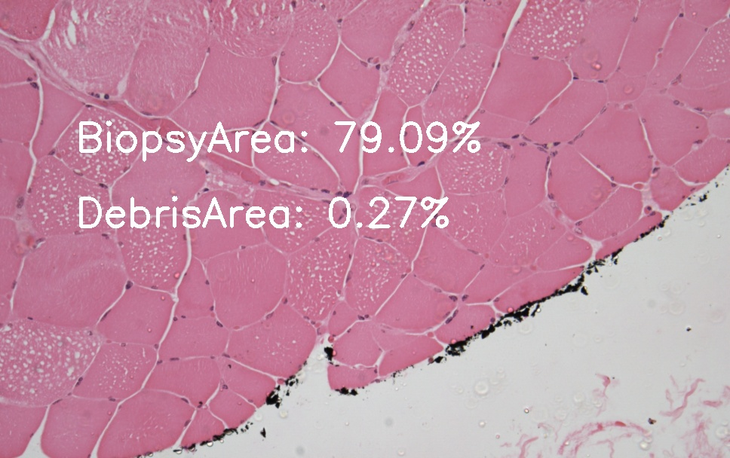
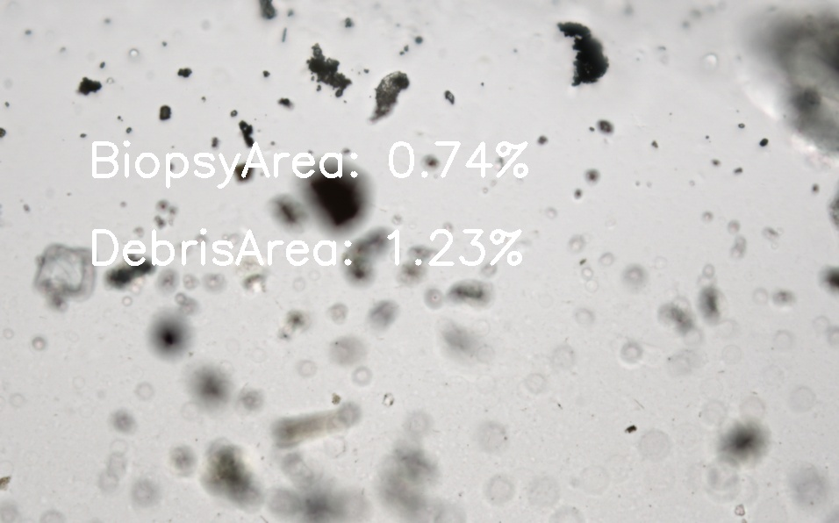
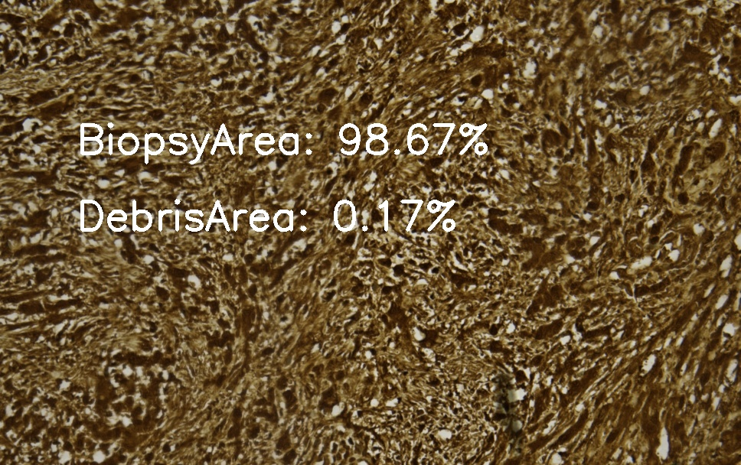
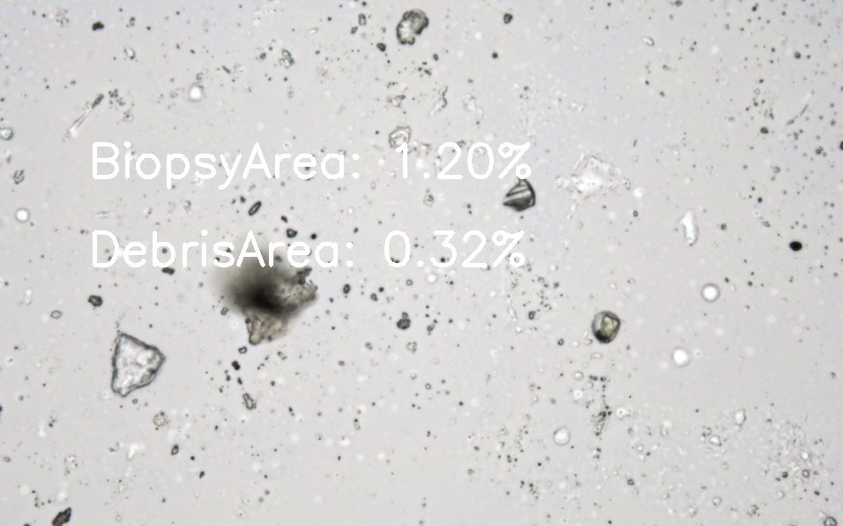
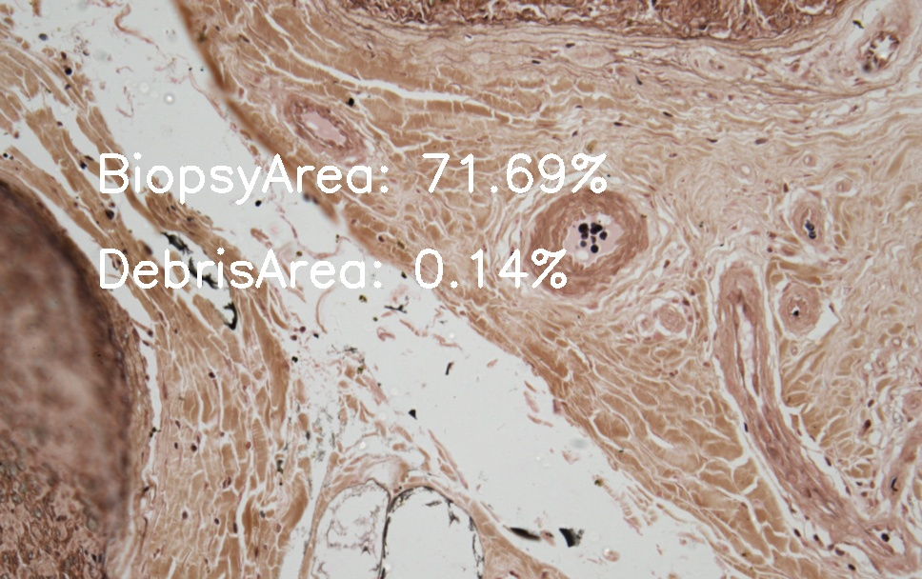
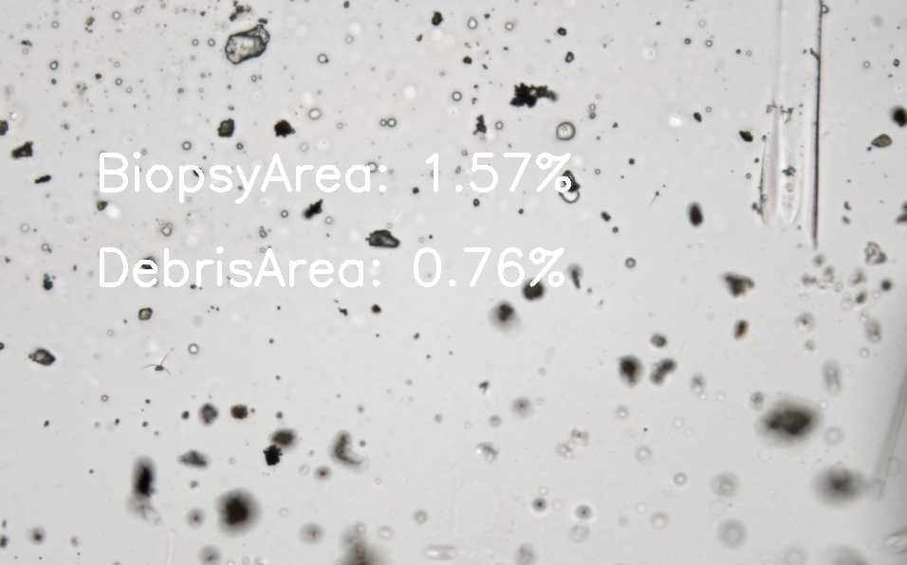
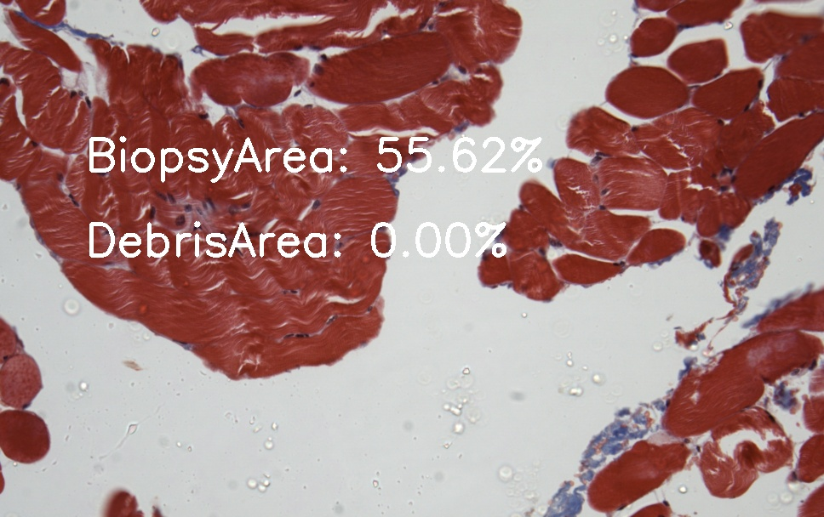
Test Cases Example
Biopsy AOI’s in all test slides were segregated in their respective class correctly with a few exceptions of very dark biopsy AOI

Slide 8
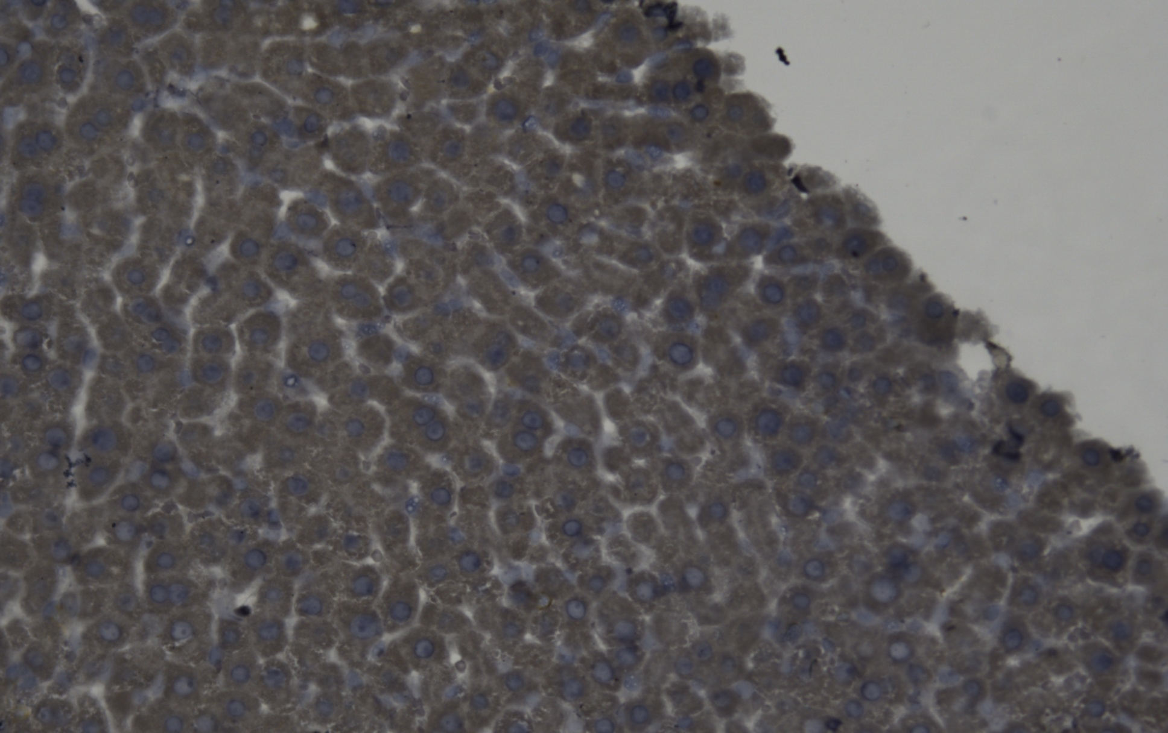
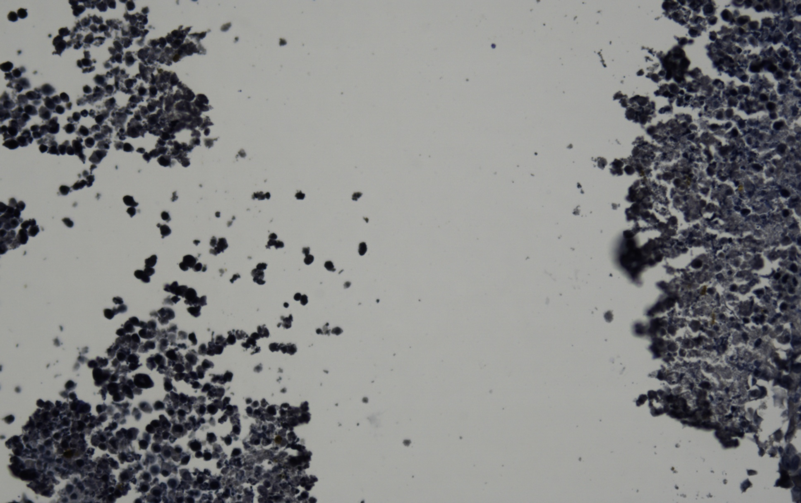
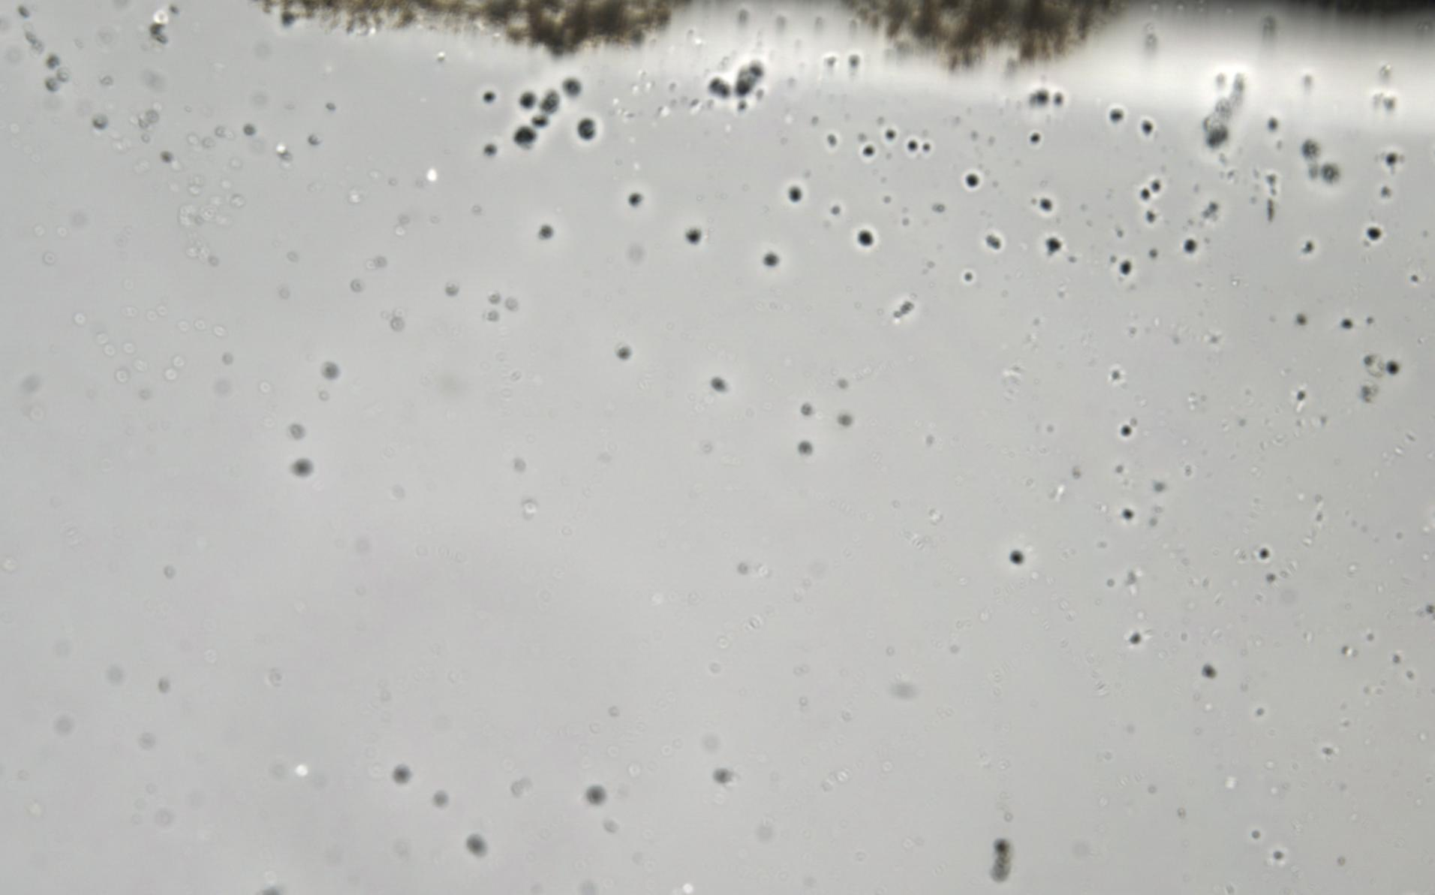
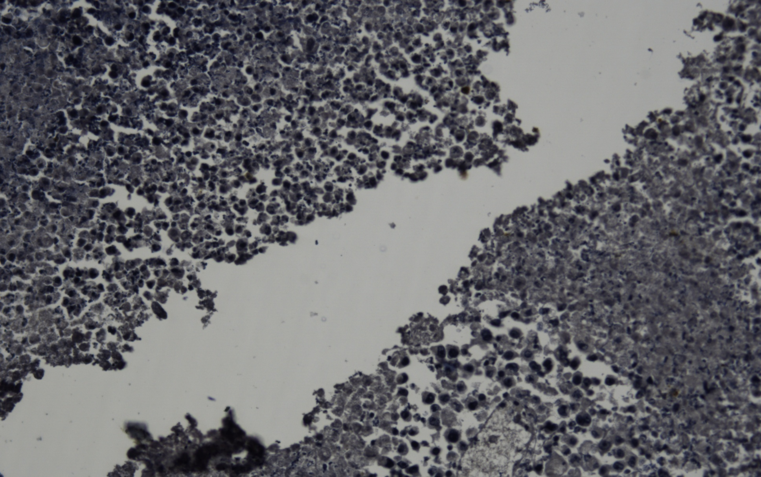
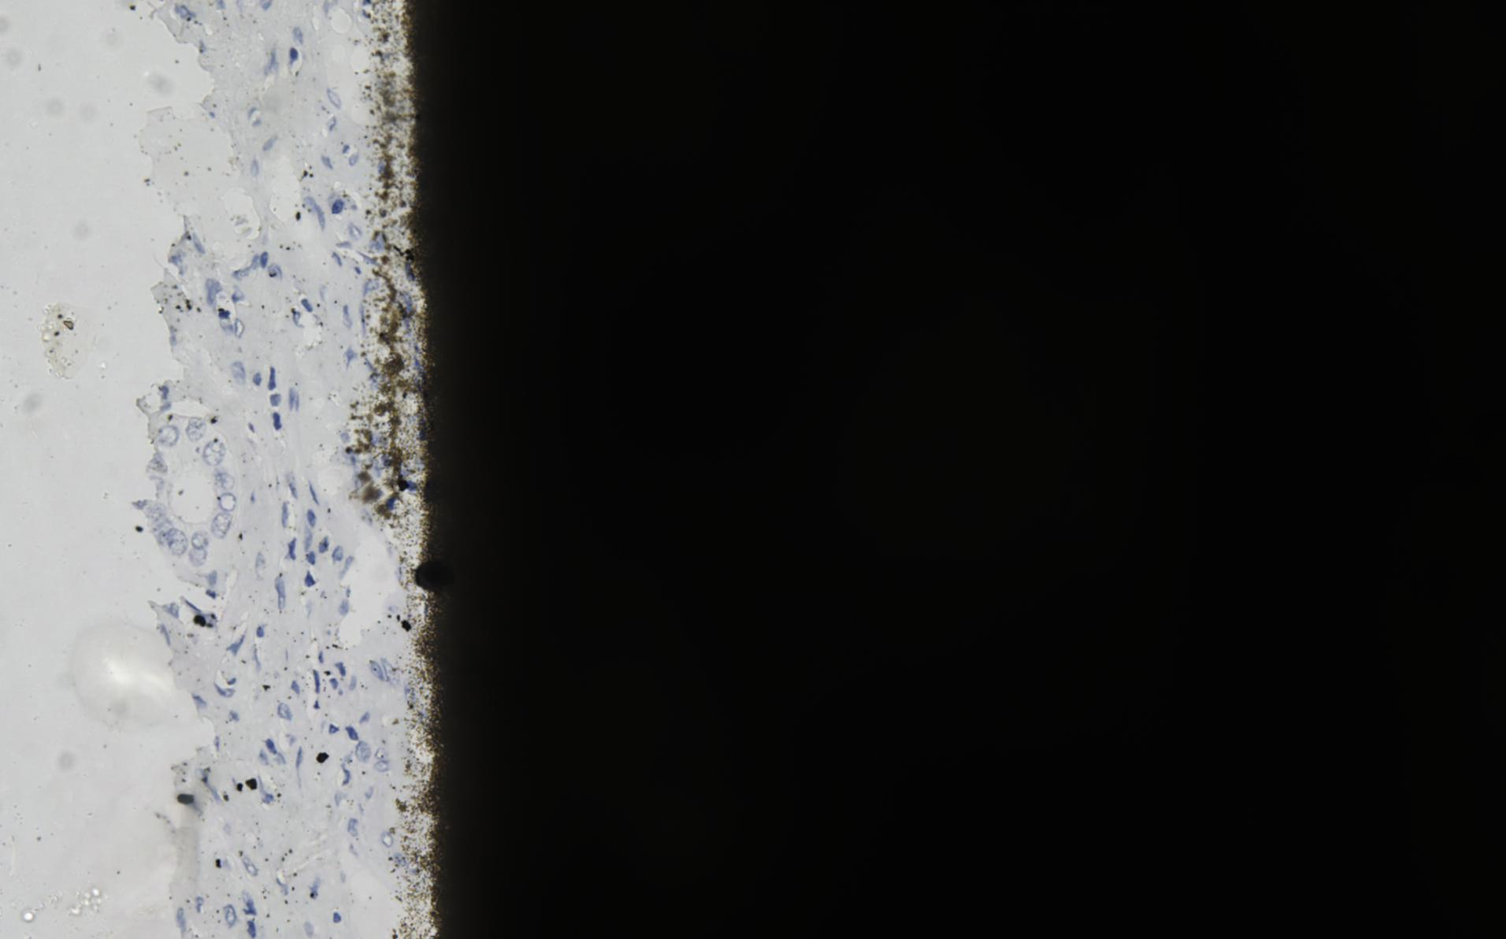
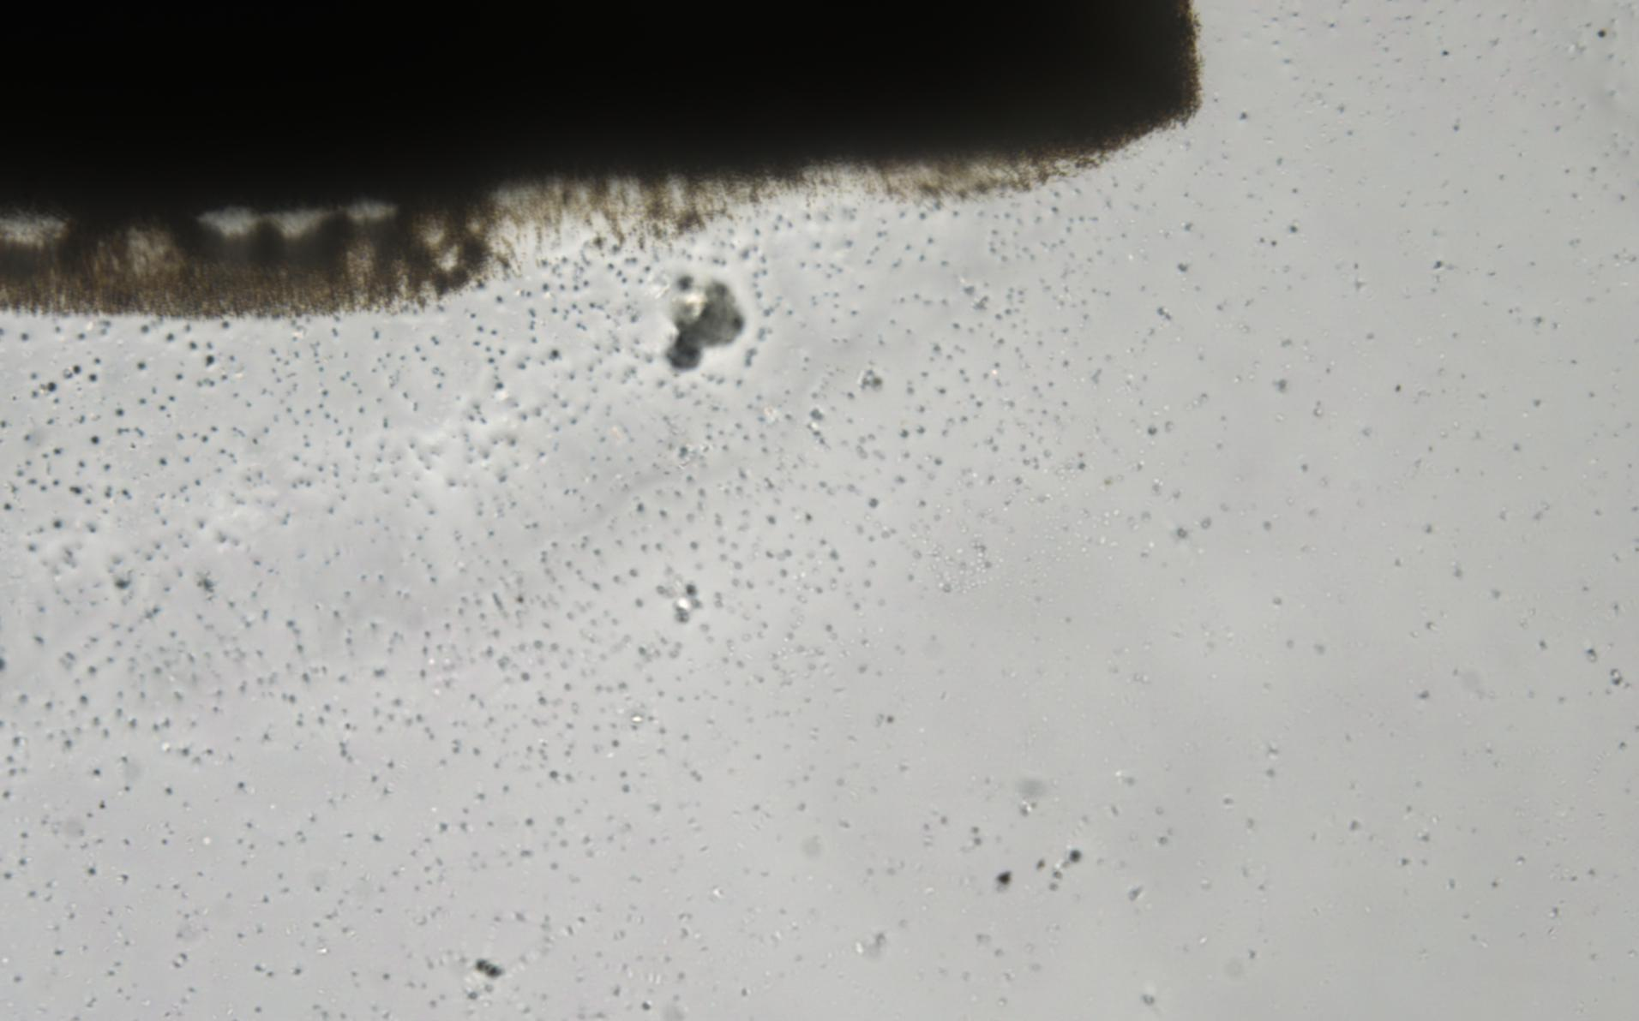
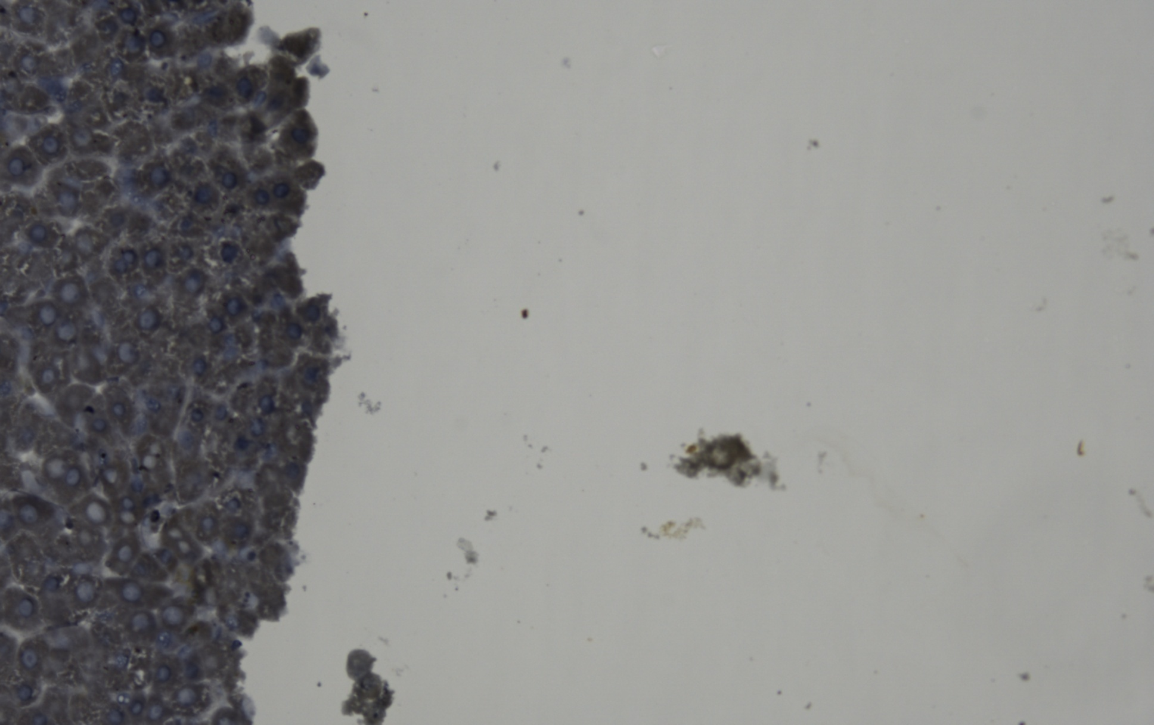
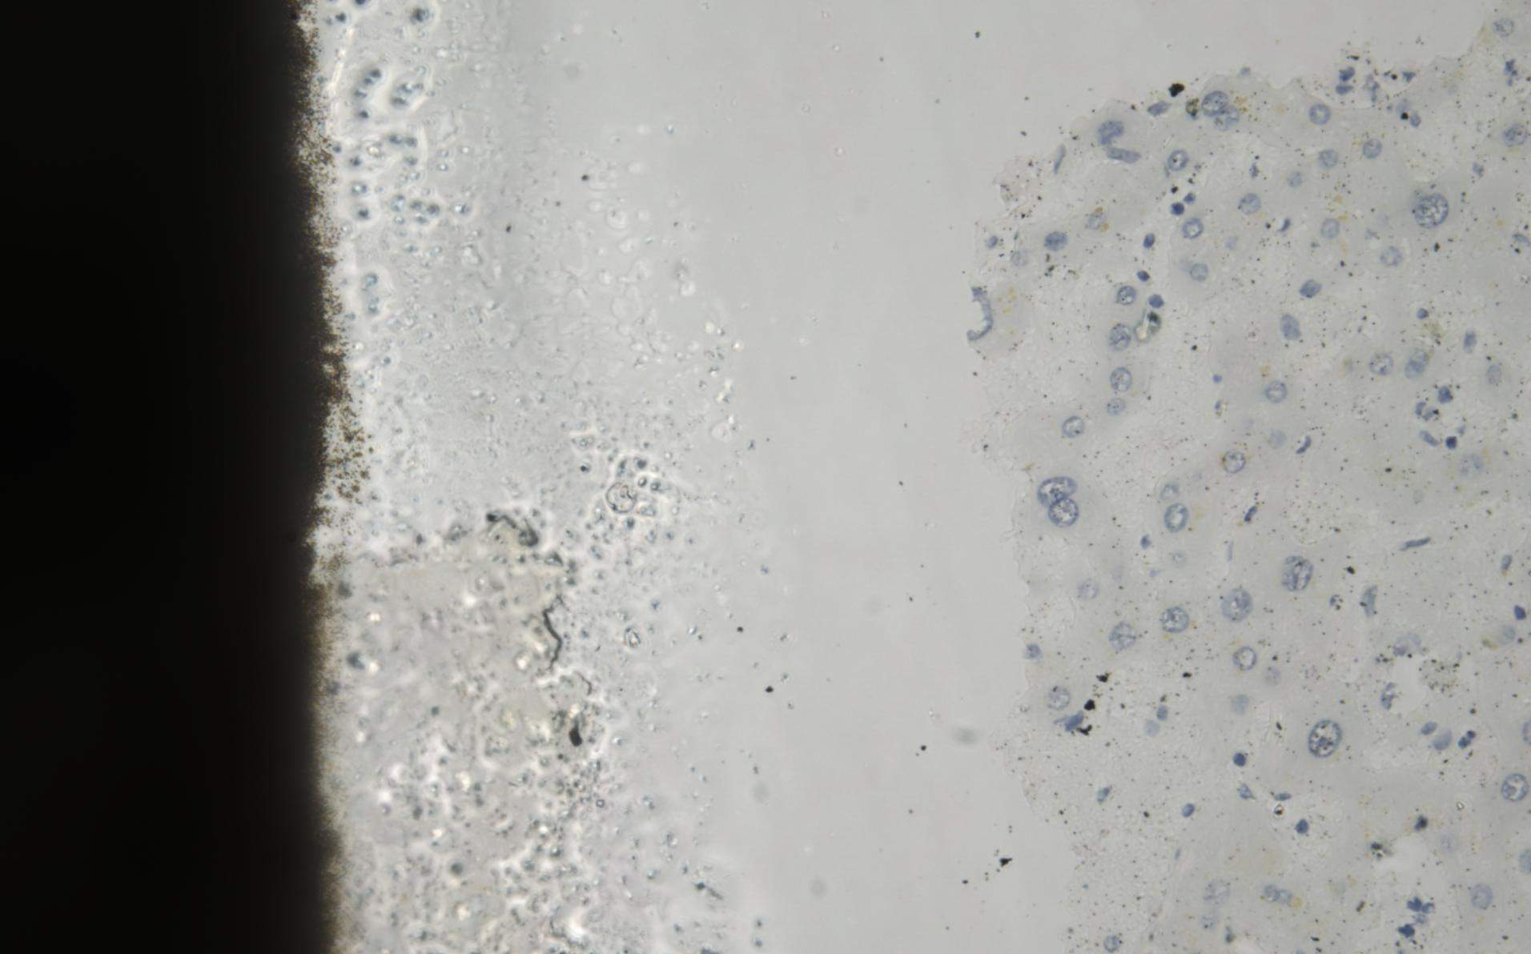

Boundary cases
Biopsy Area < Debris Area
Content Distribution:
Debris: 27.09 %
Biopsy: 1.52 %
Here, the pixels were classified as debris due to the dark color intensity
Content Distribution:
Debris: 14.52 %
Biopsy: 5.09 %
Here, the pixels were classified as debris due to the dark color intensity
Content Distribution:
Debris: 0.52 %
Biopsy: 1.43 %
Here, the content distribution was close to none hence AOI rejected
Content Distribution:
Debris: 19.75 %
Biopsy: 10.25 %
Here, the pixels were classified as debris due to the dark color intensity
Content Distribution:
Debris: 71.75 %
Biopsy: 2.50 %
Here, the content distribution for debris was much higher to the Biopsy regions
Content Distribution:
Debris: 14.14.%
Biopsy: 2.77 %
Here, the content distribution for debris was much higher to the Biopsy regions
Content Distribution:
Debris: 1.30 %
Biopsy: 17.555 %
Here, the pixels were classified as debris due to the dark color intensity
Content Distribution:
Debris: 20.57 %
Biopsy: 1.89 %
Here, the content distribution for debris was higher than to the Biopsy regions
Content Distribution:
Debris: 0.74 %
Biopsy: 0.30 %
Here, Negligible content

Slide 9









Boundary cases
Debris Area < Biopsy Area
Content Distribution:
Debris: 7.28 %
Biopsy: 20.80 %
Here, the bottom left and a few background pixels contributed in calling it out to be as Biopsy
Content Distribution:
Debris: 2.88 %
Biopsy: 35.44 %
Here, the bottom left and a few background pixels contributed in calling it out to be as Biopsy
Content Distribution:
Debris: 4.88 %
Biopsy: 9.44 %
Here, Higher the biopsy content wiht a difference the Debris pixels
Content Distribution:
Debris: 0.05 %
Biopsy: 0.12 %
Here, Neglagible content
Content Distribution:
Debris: 10.75 %
Biopsy: 2.51 %
Here, the debris content area came out to be a higher than expected
Content Distribution:
Debris: 5.28 %
Biopsy: 5.53 %
Here, the content distribution was equal
Content Distribution:
Debris: 0.01 %
Biopsy: 0.91 %
Here, Neglagible content
Content Distribution:
Debris: 14.36 %
Biopsy: 26.38 %
Here, A higher content distribution for both classes due to the dark pixels
Content Distribution:
Debris: 1.90 %
Biopsy: 4.81 %
Here, the content distribution was equal

Slide 10










































Test Slides
Following are the results obtained for different type of slide :
Slide | No. of Biopsy's/ Debris AOI Obtained Before changes | No. of Biopsy's/ Debris Obtained AOI After changes | Class Biopsy Obtained after segmentation | Class Debris Obtained after segmentation | AOI's Classified as Biopsy after proposed Methodology | AOI's Classified as Debris after proposed Methodology
 | Biopsy obtained: 2561 Debris obtained: 606 | Biopsy obtained: 2327 Debris obtained: 630
 | Biopsy obtained: 4598 Debris obtained: 454 | Biopsy obtained: 4476 Debris obtained: 477

Slide 11







































Test Slides
Slide | No. of Biopsy's/ Debris AOI Obtained Before changes | No. of Biopsy's/ Debris Obtained AOI After changes | Class Biopsy Obtained after segmentation | Class Debris Obtained after segmentation | AOI's Classified as Biopsy after proposed Methodology | AOI's Classified as Debrsi after proposed Methodology
 | Biopsy obtained: 1692 Debris obtained: 362 | Biopsy obtained: 1450 Debris obtained: 417
 | Biopsy obtained: 2934 Debris obtained: 191 | Biopsy obtained: 2418 Debris obtained: 234

Slide 12
Summary
The proposed method will remove the outliers falling in the distribution i.e, the debris AOI's with No / minimal Biopsy area
The classification is such that the high confidence regions of debris will be removed
Backgrounds with no content is more prominent and removed smudged regions as well.
The following methodology will provide us with four classes for classification :
IN Focus AOI
Out Of Focus AOI
Debris
Backgrounds

